Slide 1
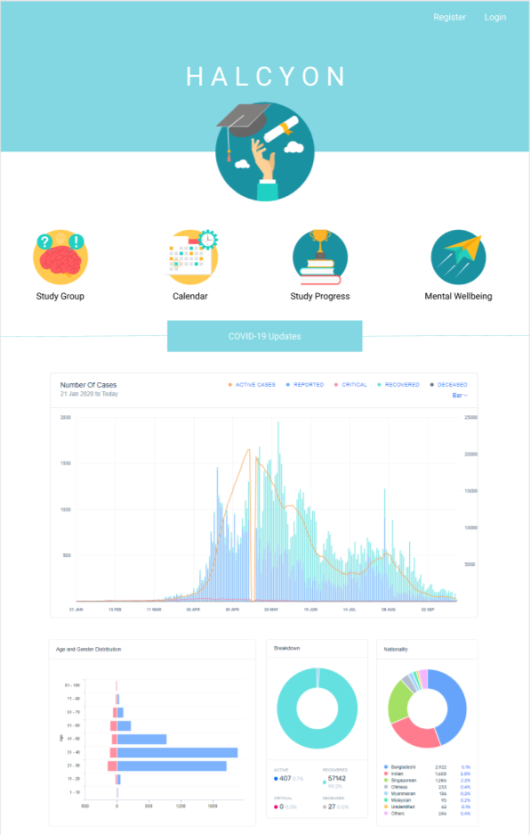
Grocery Buddy
A Halycon site
Notes:
[insert splash page]

Slide 2
Table of Contents
01
02
03
Problem and Users
Functional Requirements & Benefits
Our target audience
Features and Functions
Benefits
Non-Functional Requirements
System/Quality attributes

Slide 3
01
Problem and Users

Slide 4
Problem and Context
Elderly should avoid crowds in supermarkets but are not tech savvy to use delivery apps
Volunteers do not know which elderly needs help with deliveries
Notes:
Frame 1: show website instead

Slide 5

Users
Volunteers to help elderly
Targeted at simplifying the volunteering process, to make it more convenient for people to volunteer to deliver groceries to the elderly

Slide 6
02
Functional Requirements
&
Benefits

Slide 7
Halcyon’s Features
Personal account
Map View
Shopping List
Volunteers login as unique accounts to track their activity and earn rewards
Show locations of homes that need groceries on a map, filtered by date required
Auto generated shopping list based on location proximity

Slide 8
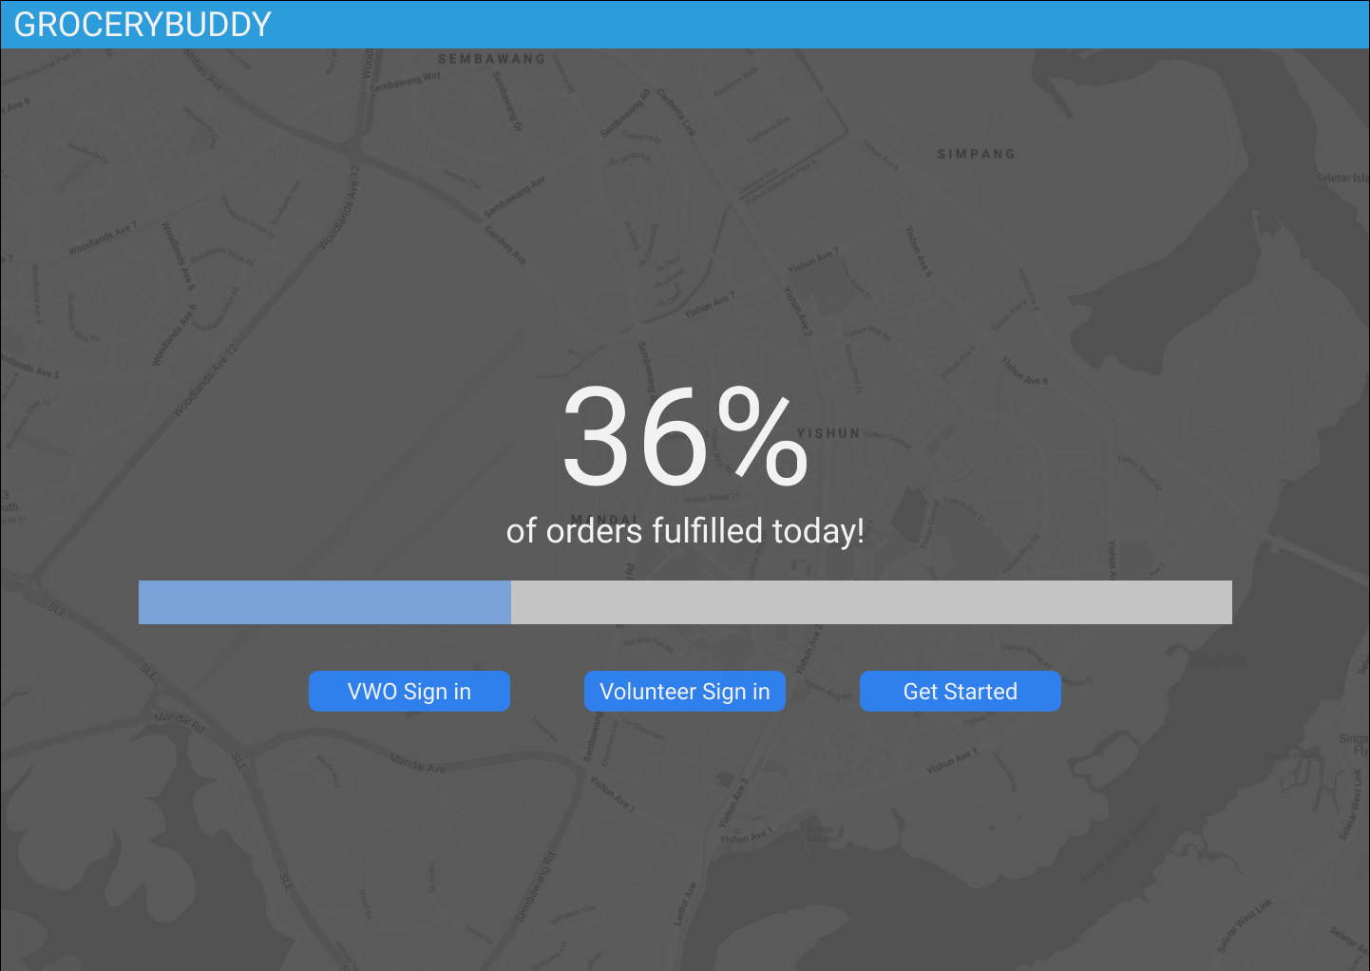
Splash Page
Select volunteer sign up (to deliver groceries)
OR
Sign in for:
volunteers to schedule deliveries
VWOs to input elderly information

Slide 9
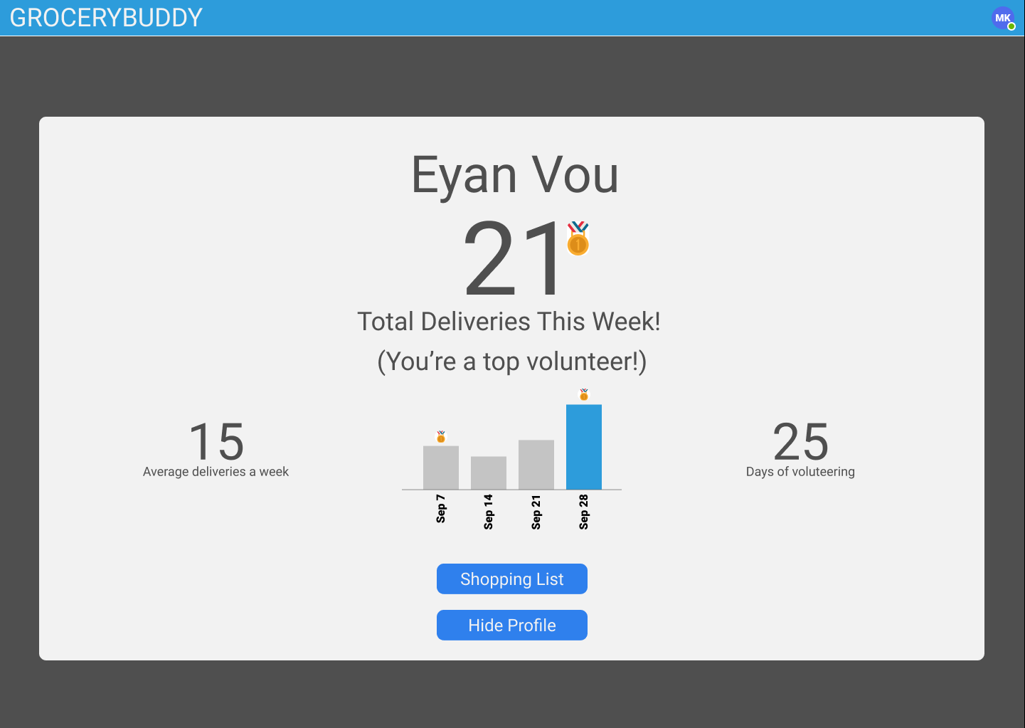
Personal Account
Volunteers can input their intentions to go to the supermarket and their location information
Benefits
Personalised storage of persistent data such as planned deliveries/ shopping lists and volunteering statistics
Track their activity and earn rewards

Slide 10
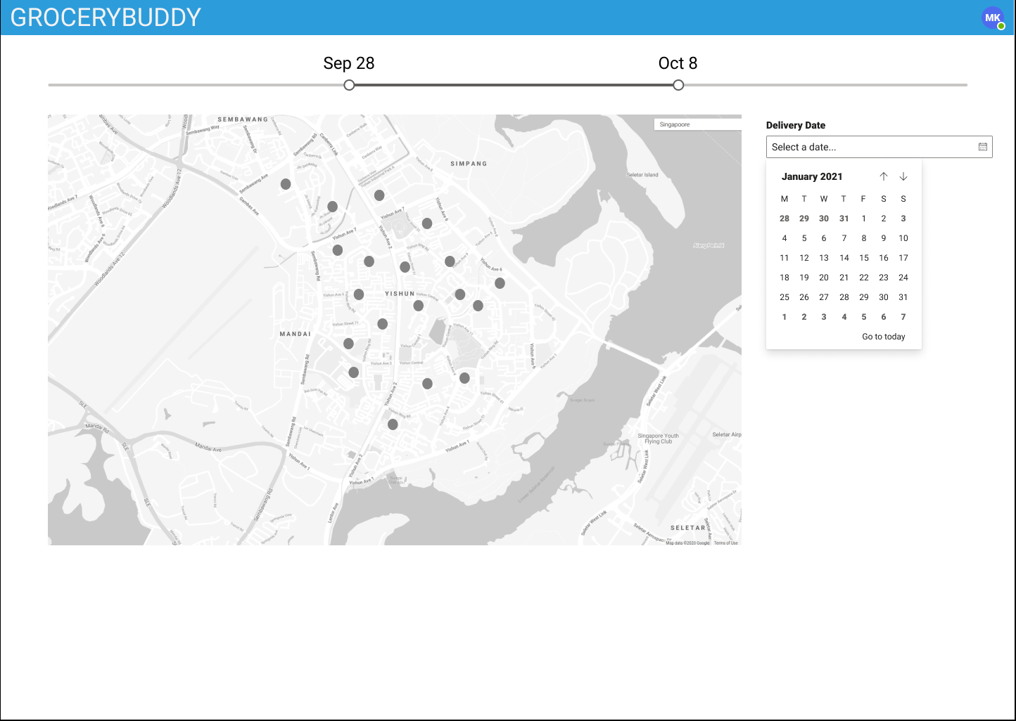
Map View
Displays the locations of homes that needs groceries filtered by delivery date.
Benefits
Allow volunteers to view destinations spatially
Allows better planning to target high density clusters

Slide 11
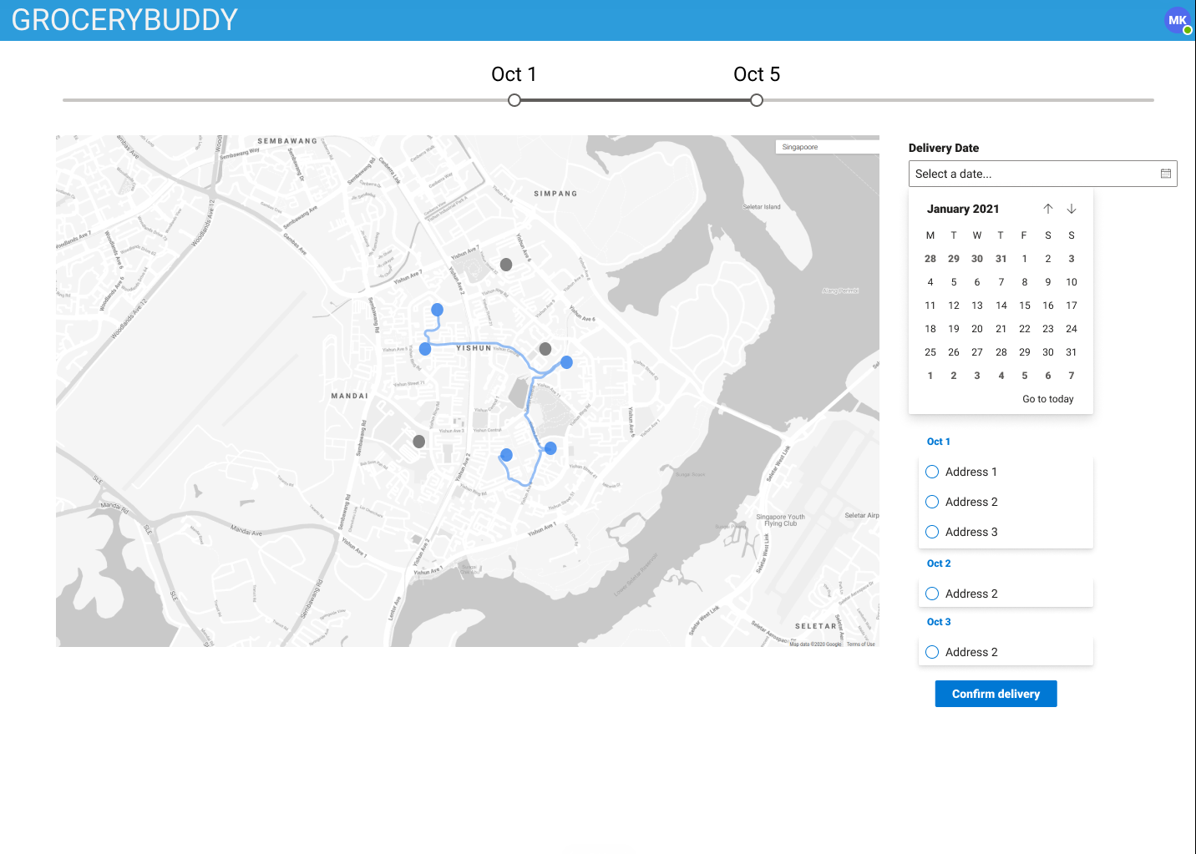
Map View
Shows the homes suggested to deliver groceries to based on volunteer input supermarket and home locations.
Also suggests travel route integrated with Google Maps API

Slide 12
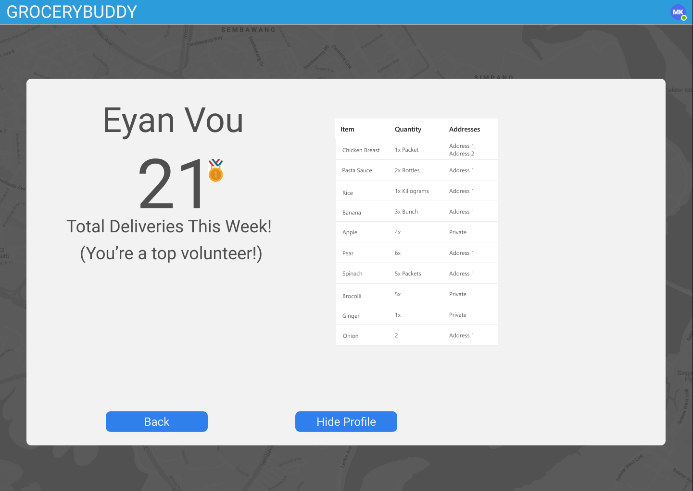
Shopping List
Auto generated shopping list which can be grouped by grocery item (when making the purchase) and delivery destination (during delivery)

Slide 13
03
Non-Functional Requirements

Slide 14
Non-Functional Requirements
Simplicity
Halcyon pursues minimalism, meaningful results
Usability
Personalised recommendations
Performance
Realtime suggestions for each unique user depending on urgency and destination of delivery
Security
Halcyon will provide a secure database and network for the users details and messages in the application

Slide 15
Thank You

